Slide 1

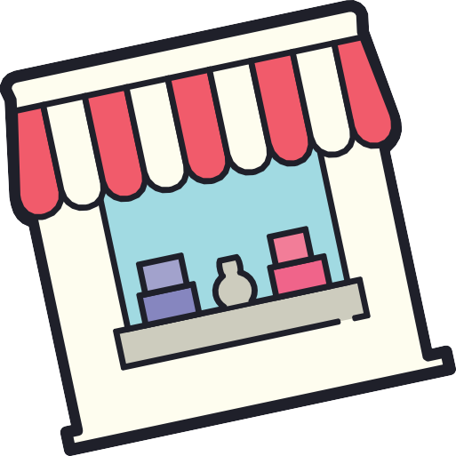
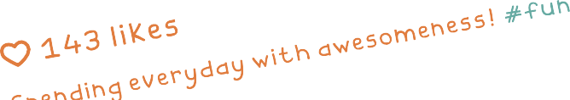
MARKETPLACE FEATURE FOR INSTAGRAM
Virendra Kumar Verma
IIT Guwahati
190122057

Slide 2

PROBLEM
STATEMENT
Observed that apart from users sharing their pictures and videos and content creators moving towards monetization through their content, the number of small businesses have been growing especially since the onset of Covid, with followers and reach in thousands or even millions.
I have decided to propose a marketplace feature, where-in small businesses can set up shops, and searching and shopping at such businesses become easier for users.

Slide 3
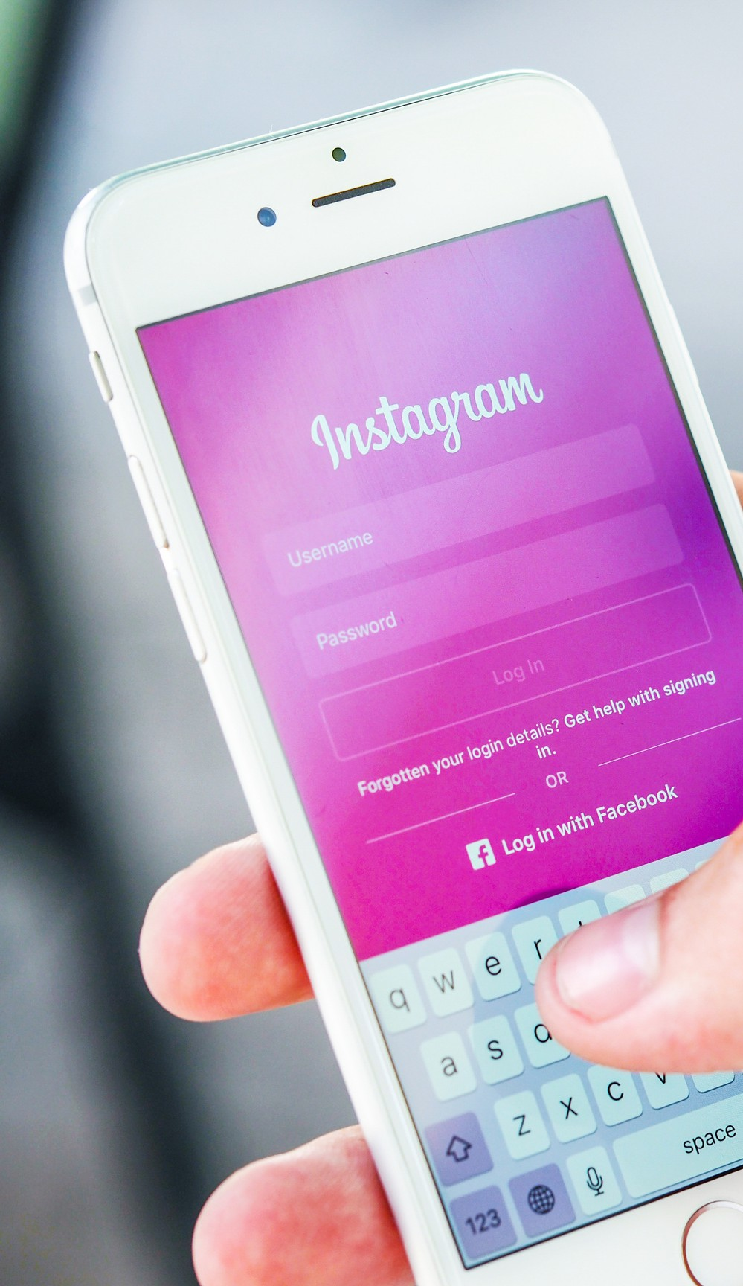
ABOUT INSTAGRAM
“Give people the power to build a community
and bring the world closer together”
Instagram is a social media platform that emphasizes photo and video sharing. Users can interact with others’ content via likes, comments, shares, and saves.
In 2022, Instagram is currently ranked 4th out of all social media networks worldwide, with over 2 billion people using the app each month. India boasts of the maximum number of Instagram users, with 230 million users logging in from India. Also, increasing its audience by 16% quarter-over- quarter, India is the fastest-growing region for Instagram currently.

Slide 4


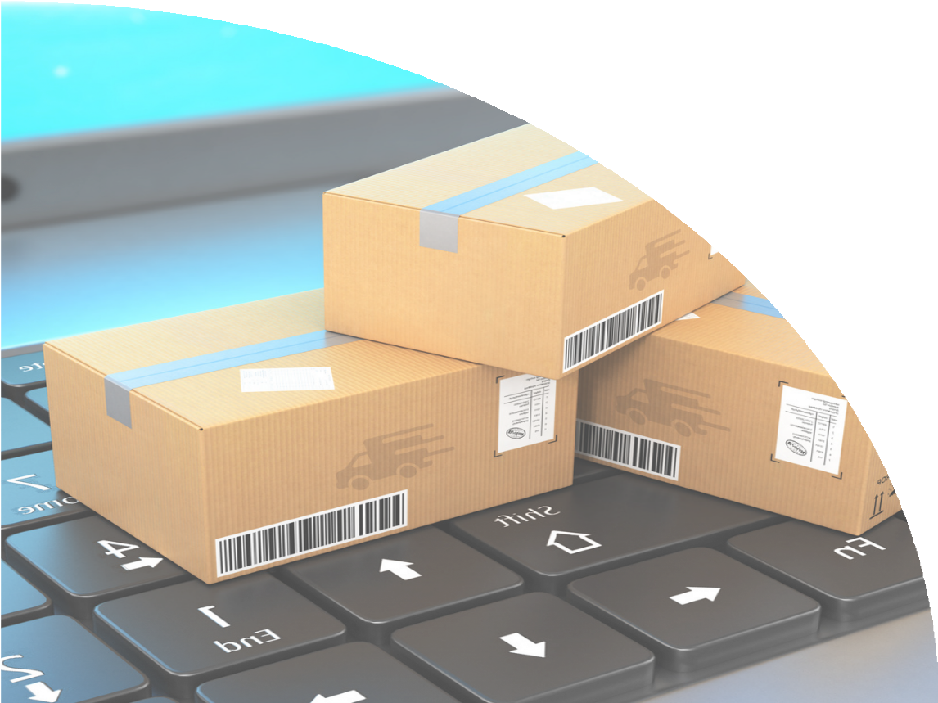
OUR GOAL
To empower small business owners with a marketplace feature.
USER-SEGMENT
In this case, we will be concentrating on two kinds of users.
Users who runs small businesses on Instagram
Users who buys products via Instagram

Slide 5


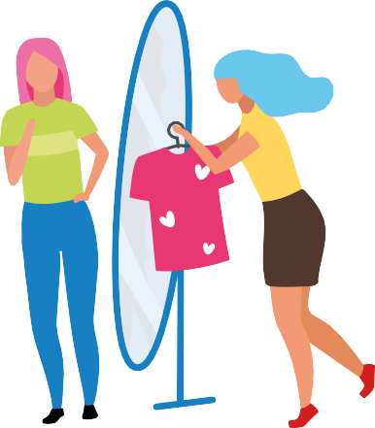

USER-STORIES
1. Rajvi Patel
23-year-old Instagram thrift store owner
Rajvi runs a small business of thrift clothes, and she takes all orders from Instagram only. She manages things all alone but diving into trends with Instagram reels has really helped her to gain engagement.
2. Maya Sharma
30-year-old Instagram user and Rajvi'a Customer
Maya is an active Instagram user. She is fond of small-business products. She feels they are unique and affordable.

Slide 6
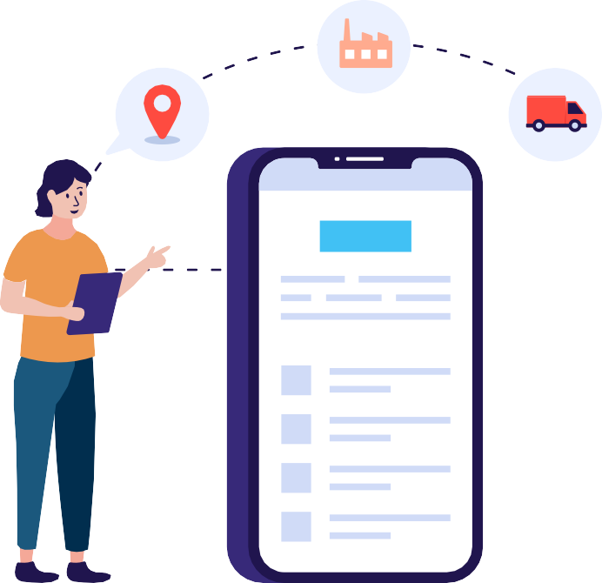
PAIN POINTS
Have to take manual note of incoming orders
It becomes difficult to take note of all the details manually
from IG chat while confirming order.
Official reviews and rating is not there, required to win customers trust.
these points are
PROPOSED SOLUTIONS
1. Separate small business account category
under public account section and some
can be built
customized
features can be released under this.
2. Separate option to directly placing the order
Adding payment options and order tracking feature
Allowing customers to add reviews and ratings product.
to the
5. Including live updating avability of orders for customers

Slide 7



PRIORITZING SOLUTION
Out of previous solutions we can go with no 1 and 2 for now, as it will be more viable to start slow with lesser feature for implementation
Hence, we will be creating a separate category
under public
Business".
And we can
business account named as "Small
start slow paced and with one or two
basic features to make it easy to use.
Lets have look how it would look and work after its release!

Slide 8

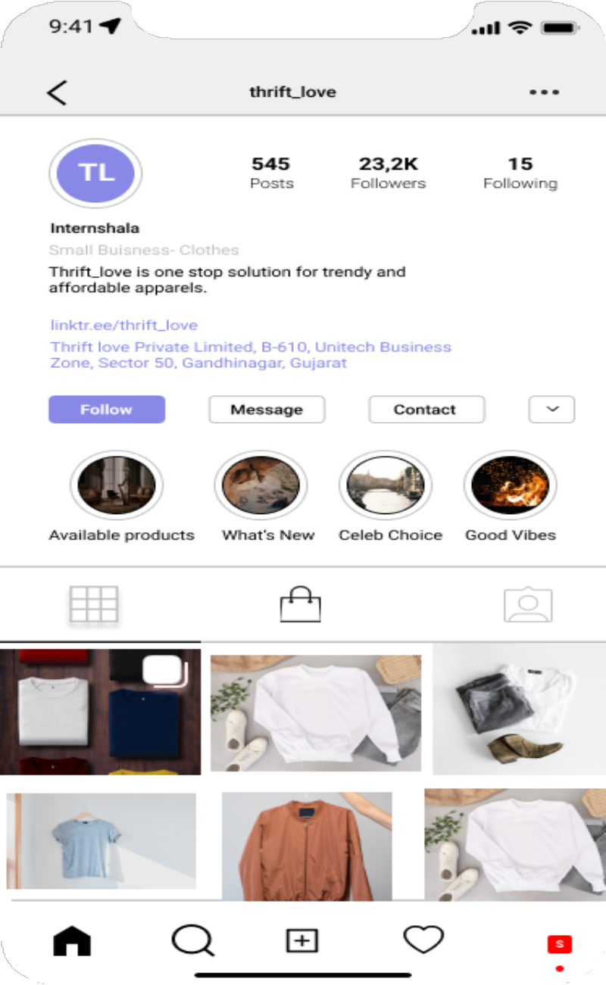
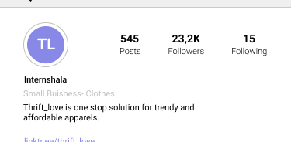
WHAT BUYERS WILL SEE
Buyers will able to see all the products listed on the Instagram page under shopping bag icon.
Small business can be classified from the text details on their Instagram, here it is "Small Business - Clothes".
Similar phrase "Small Business - Clothes" can be used to search nearby or most relevant shops from search tab.
Instagram bio page of small buisness account holder

Slide 9
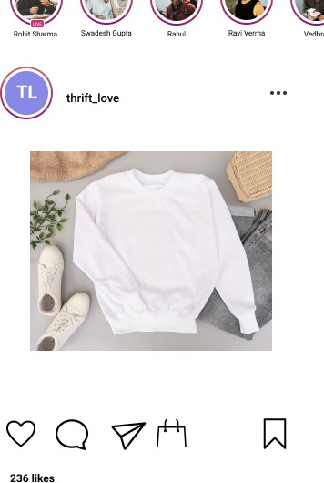
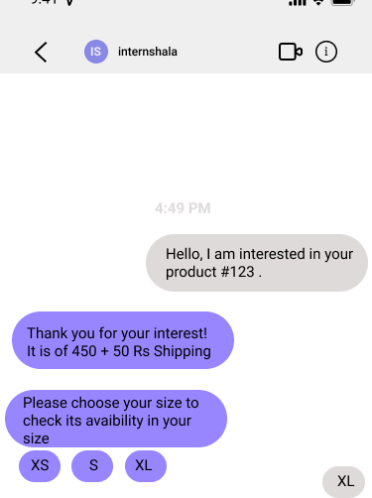

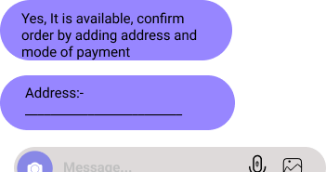
HOW IT WORKS
For sellers, posting their product under this list will be similar to posting photos on Instagram.
Buyers will be able to buy product by tapping Bag icon above caption. When tapped, buyer will be redirected to the chat of that particular account
Tap on bag icon above the caption.
It will redirect to the chat with auto generated message.
Seller will be able to responds immediately with same type of automated responses.
Example of auto generated message from a buyer.

Slide 10
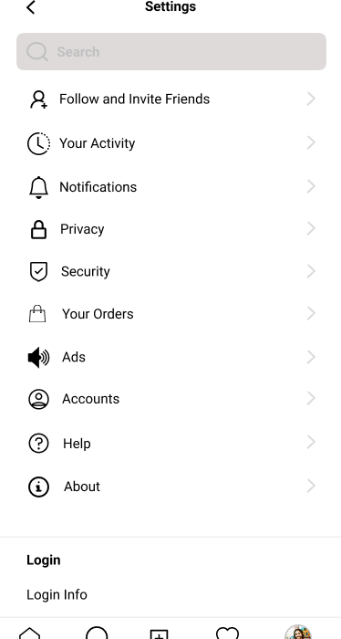
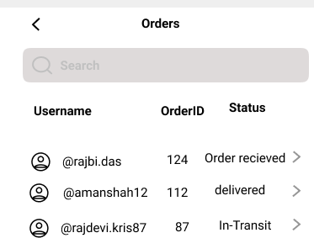

WHAT SELLERS WILL SEE
On confirmation of order from chat, it can be easily stored in Your orders section.
Orders will get orders ID and status can be updated by buyers.

Slide 11
GO-TO-MARKET STRATEGY
Interviewing customers for reviews and make necessary changes
Analyzing target market and competitiors
Launching Beta version and
testing the feature
Relaunching the feature and repeat same process

Slide 12
SUCCESS METRICES
No. of small business users
No. of Order placed via IG
Most prominent metrices will
be No. of small business users, this numbers will play vital
even if decide to monetize this feature
% of new customers aquired per business
Customer satisfaction score

Slide 13
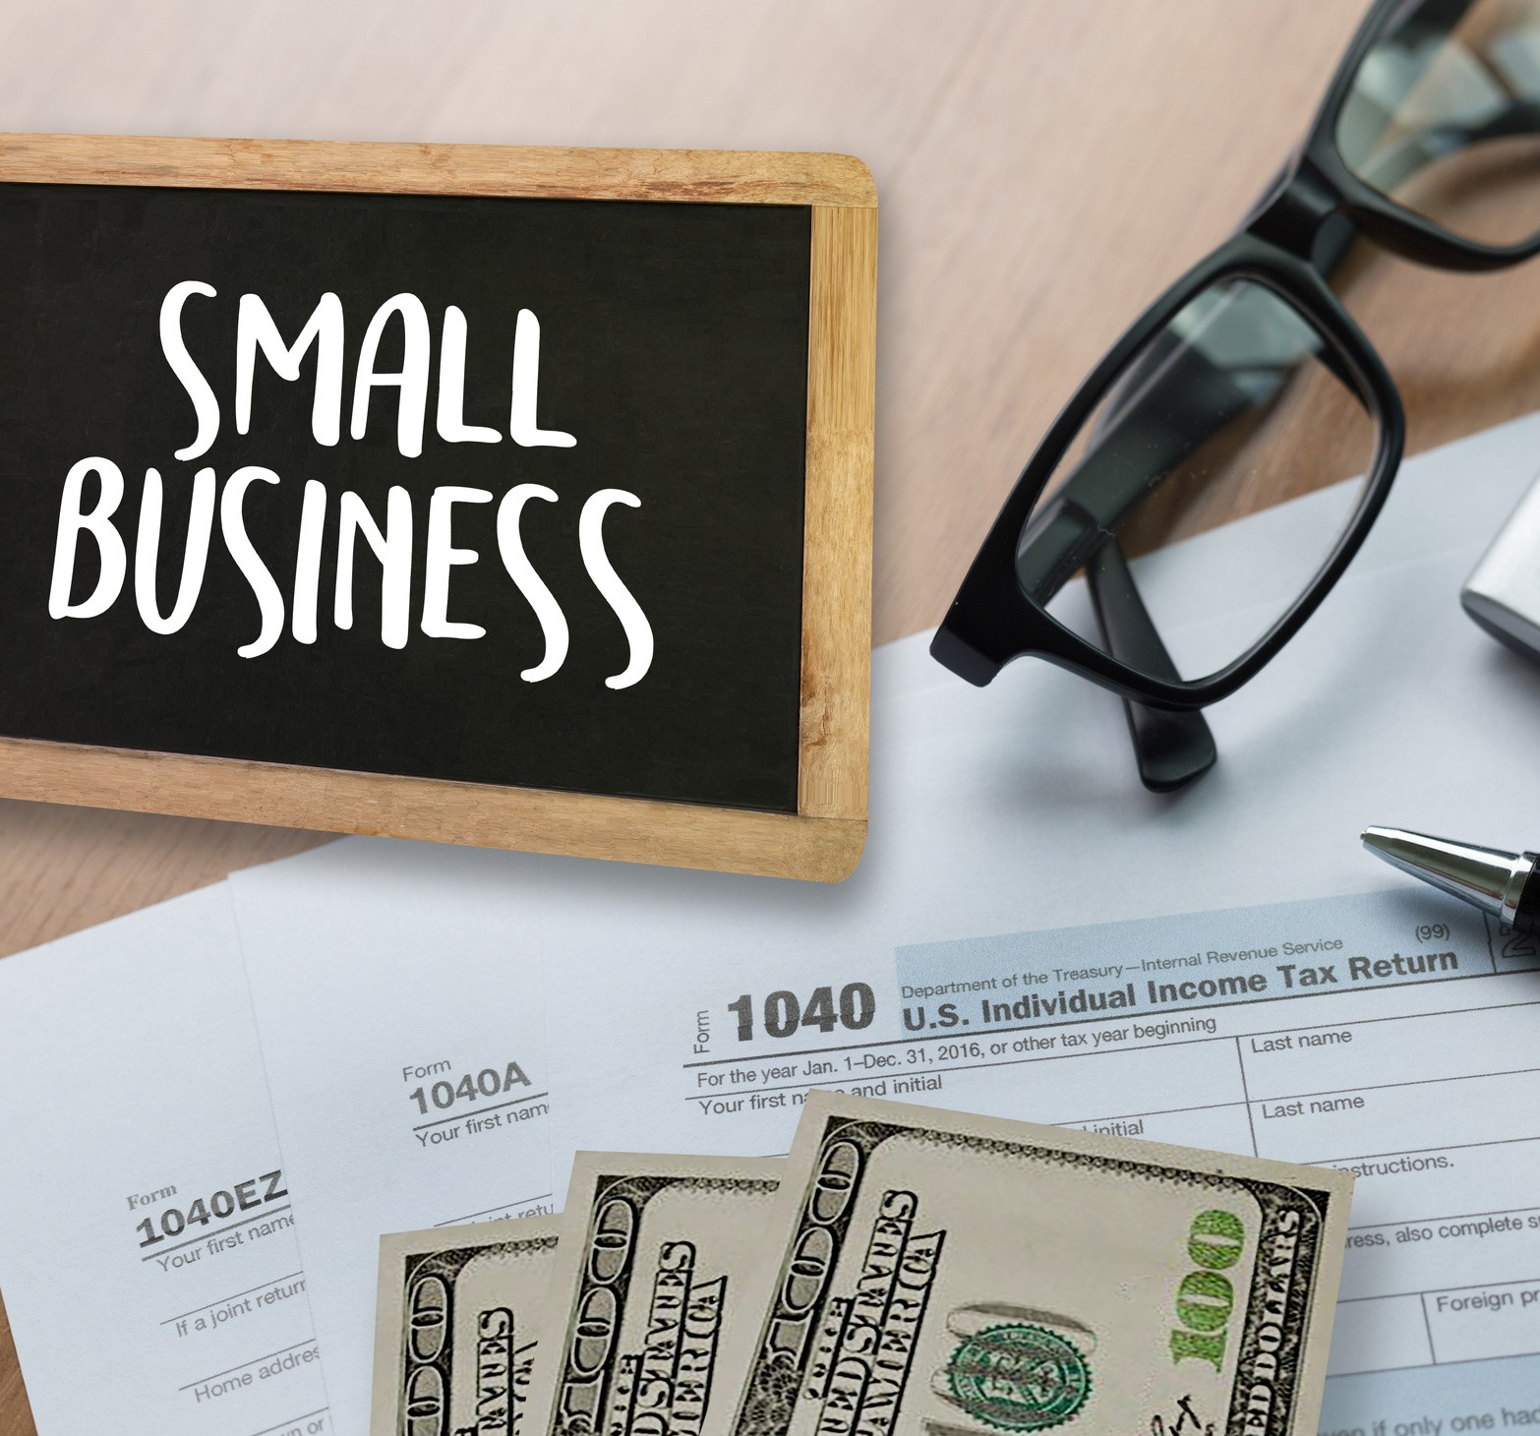
THANK YOU

